Slide 1


Bankruptcy Prediction System
Author : Middi Yogananda Reddy

Slide 2
CONTENTS
1. Project Description and Dataset
2. Objectives
3. Methodology
4. Model Comparison Table
5. Model Selection
6. Results
7. Streamlit Dashboard Demo
8. Conclusion

Slide 3


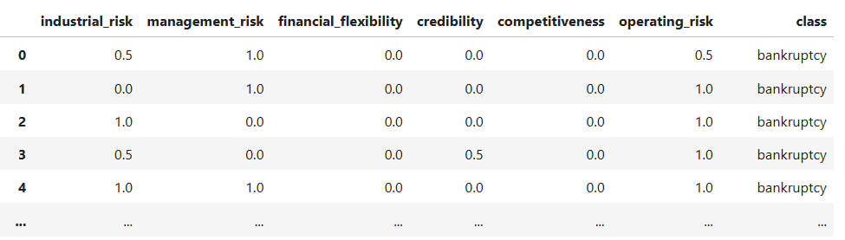


1. Project Description and Dataset
1
Predict company bankruptcy using key financial risk indicators.
2
Dataset: 250 samples, features—Industrial Risk, Management Risk, Financial Flexibility, Credibility, Competitiveness, Operating Risk, Class (bankruptcy/non-bankruptcy).

Slide 4



2. Objectives
Analyze which features contribute to bankruptcy.
Compare multiple machine learning classifiers for prediction accuracy.

Slide 5







3. Methodology
1
2
Data preprocessing: null values, duplication removal, encoding,
scaling.
Data visualization: feature distributions, class balance.
3
4
Feature correlation analysis.
Machine learning models used:
• Logistic Regression
• KNN
5
• SVC
• Decision Tree
Metrics: accuracy, precision, recall, F1 score, confusion matrix.
• Naive Bayes
• Random Forest

Slide 6
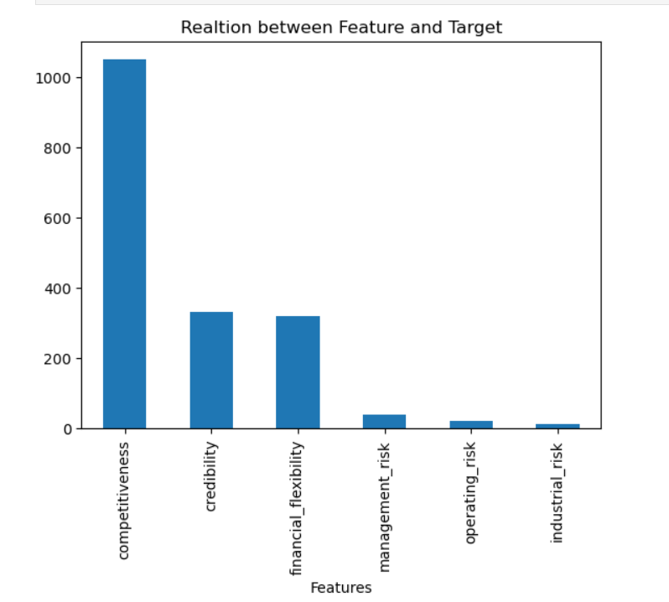
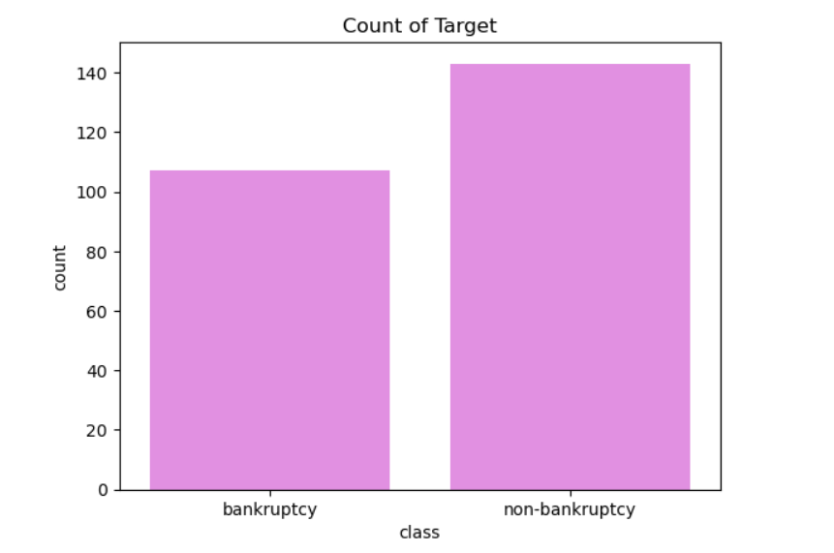
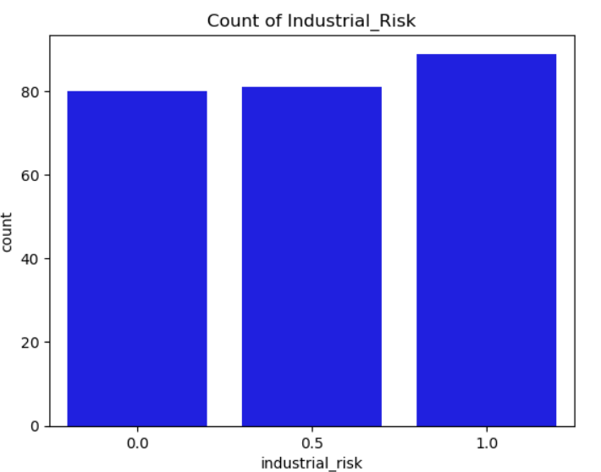
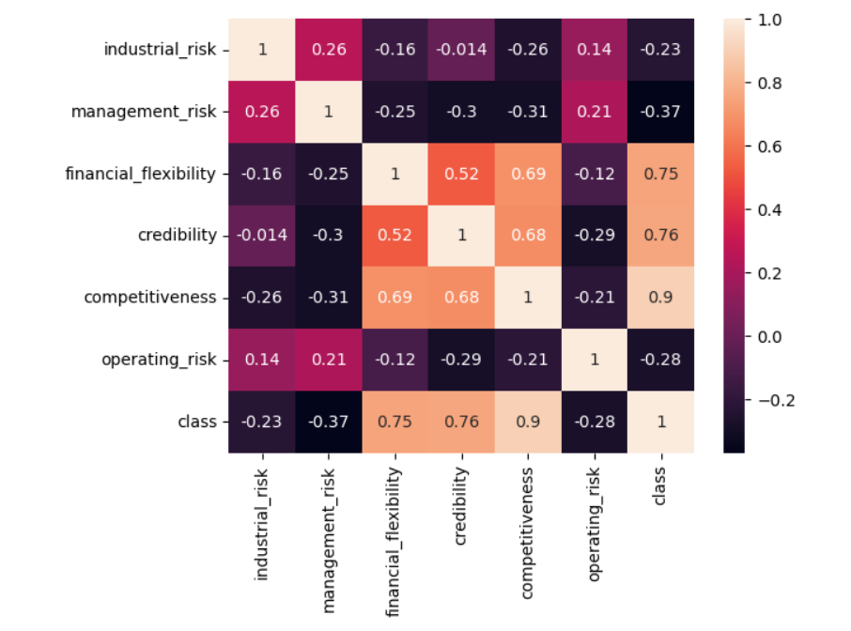
Visualization
Relation between feature and target using ANOVA
Distribution of target variable
Count of industrial risk
Correlation heatmap of feature and target variable

Slide 7
4. Model Comparison Table
Model | Accuracy | Precision | Recall | F1 Score
Logistic Regression | 1.00 | 1.00 | 1.00 | 1.00
KNN | 0.98 | 1.00 | 0.97 | 0.99
SVC | 1.00 | 1.00 | 1.00 | 1.00
Decision Tree | 0.95 | 1.00 | 0.92 | 0.96
Naive Bayes | 0.98 | 1.00 | 0.97 | 0.99
Random Forest | 0.98 | 1.00 | 0.97 | 0.99

Slide 8
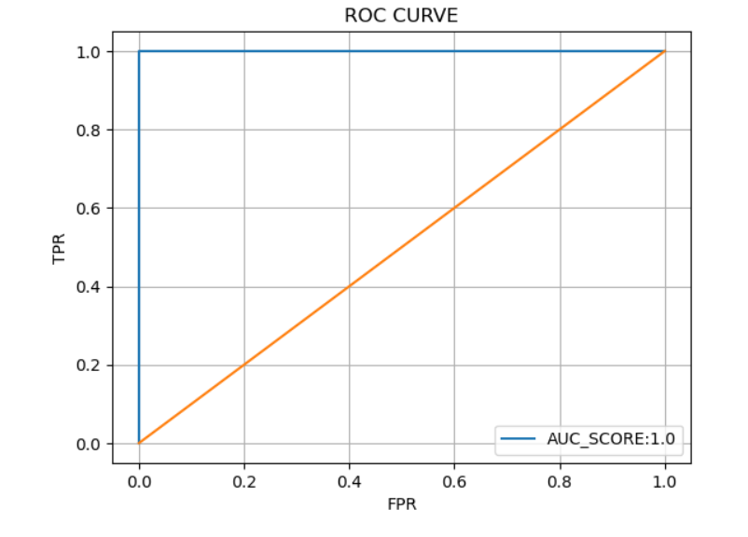
5.Model Selection
Logistic Regression was chosen due to its outstanding performance (Accuracy, Precision, Recall, F1 Score: 1.00).
ROC Curve shows near-perfect discrimination, confirming model reliability.
Key financial features such as net profit and liabilities strongly influenced predictions.
ROC curve for logistic regression

Slide 9






6. Results
1
Most models achieve >95% accuracy.
2
Logistic Regression outperforms all with perfect accuracy, precision, recall, and F1 score.
3
Key financial indicators like net profit and liabilities are the most
influential features in predicting bankruptcy.

Slide 10
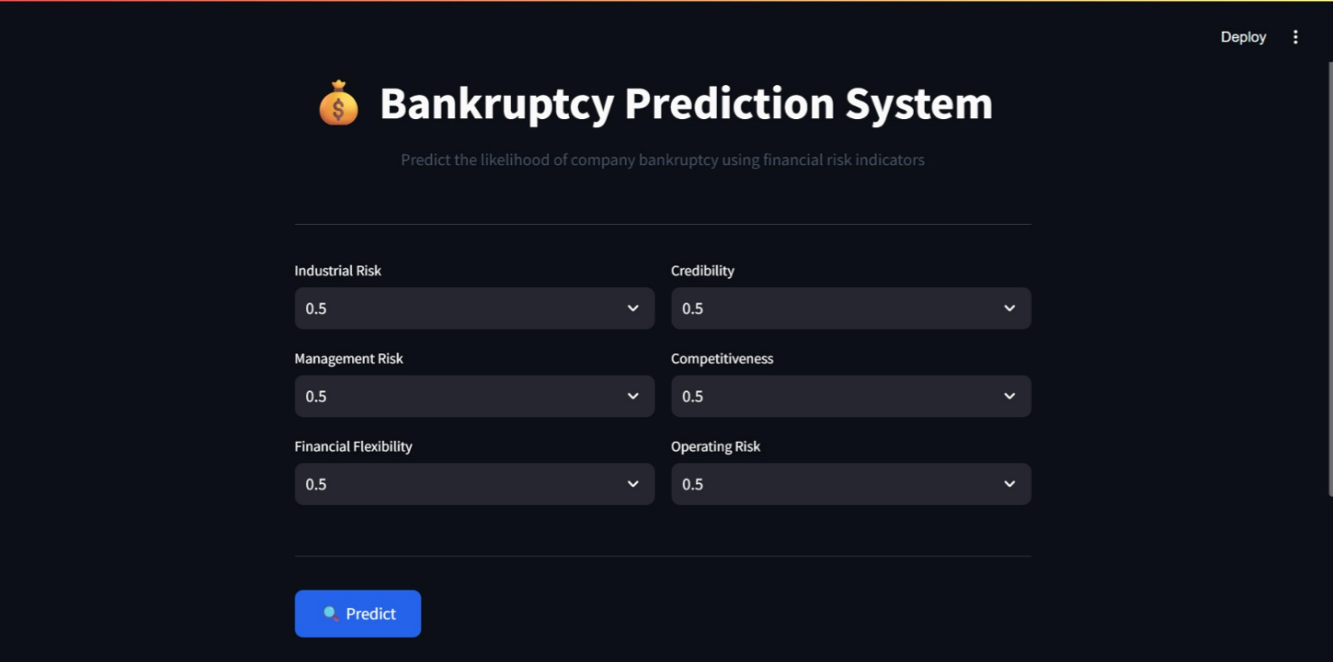

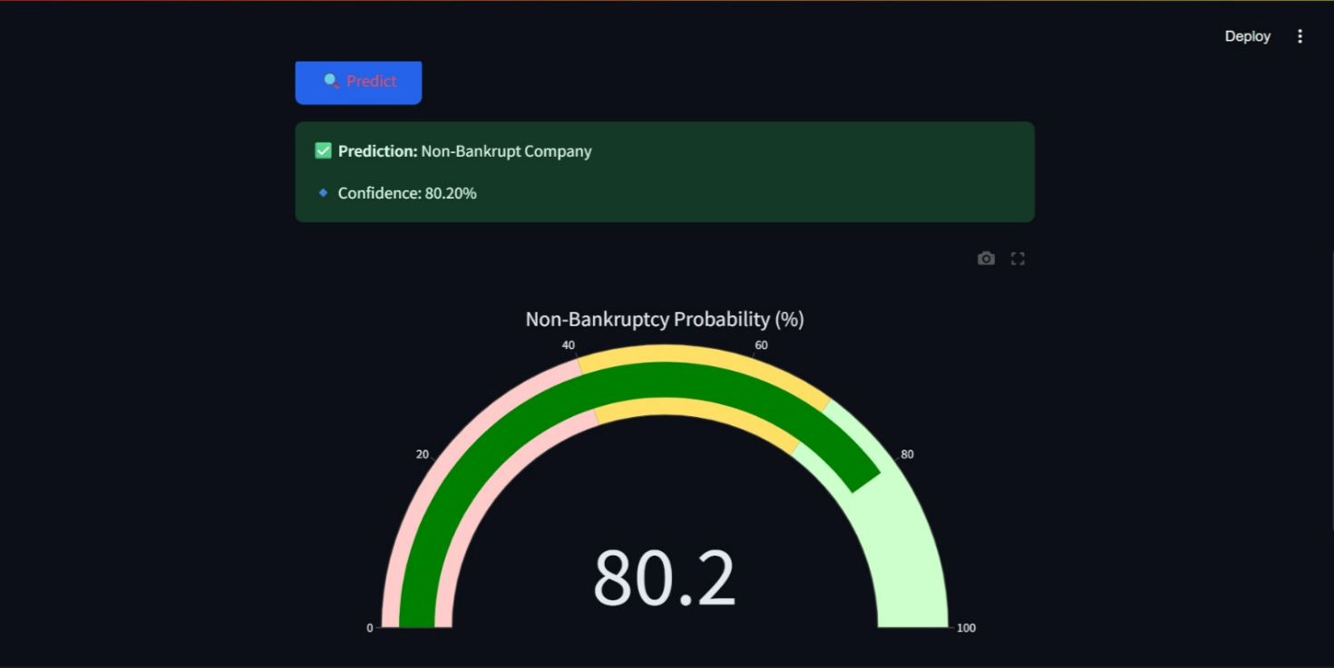

7. Streamlit Dashboard Demo
Web app allows users to select financial risk factors to view bankruptcy probability.
Dashboard instantly displays bankruptcy status (Bankrupt/Non-Bankrupt)
along with the confidence percentage.
Interactive gauge chart visualizes prediction probability
for easy interpretation.

Slide 11


8. Conclusion
1
The model predicts bankruptcy accurately by analyzing key financial risk factors.
2
This approach enables companies and investors to make better, data-driven decisions.
3
The dashboard helps users interpret prediction results quickly through interactive visuals.

Slide 12
9. Future scope
1
Expanding the dataset to include more types of financial data can further
improve prediction quality.
2
Testing advanced machine learning models may enhance accuracy and reliability.
3
Integrating the model with external financial systems via API, allowing seamless
access to predictions for businesses and analysts.

Slide 13
Thank You!

